Slide 1
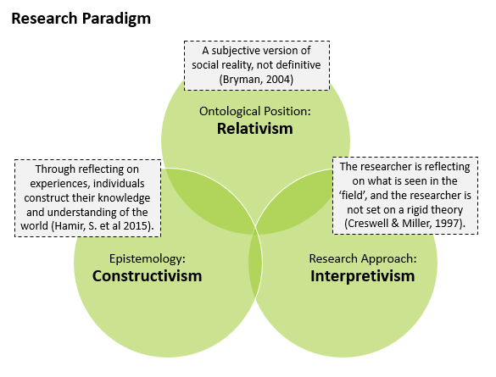
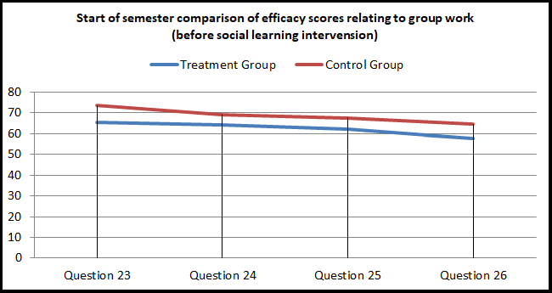
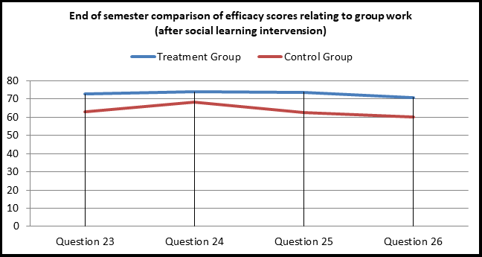
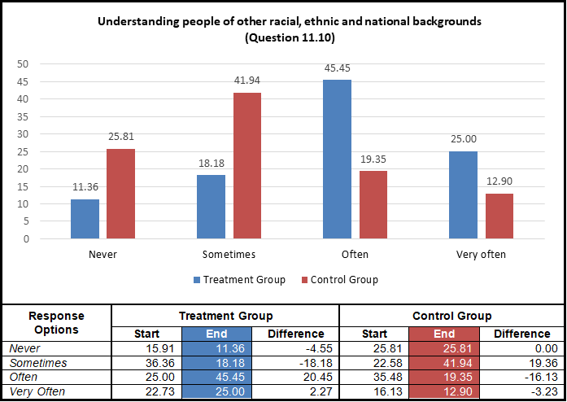
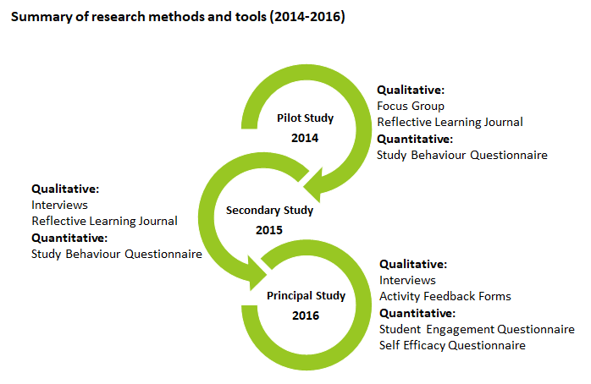
Cultivating Academic Self-Efficacy through supportive social and self-regulated learning strategies
for students in higher education
Graham Glanville, CCT College Dublin / University of Hertfordshire (EdD Cohort 9), May 2019
Part 1. Description of problem domain, motivation and data set
mydata$year <- as.integer(format(mydata$date, "%Y")) mydata$is_new <- as.integer(grepl("^New", mydata$desc)) mydata$is_dublin <- as.integer(mydata$county == "Dublin")
FINDINGS
Self Efficacy
Reflective Learning
Participants were provided a self-efficacy questionnaire, based on a approach suggested by Bandura (2006), to complete at the start and end of a semester. A social learning intervention was introduced to a treatment group, and the overall self-efficacy group score comparison revealed very little, other than a slight increase in the treatment group score. However, a significant finding was found when comparing the final four questions measuring the perceived ability to work within a group. To illustrate this, the first figure below represents the start of semester self-efficacy group score for both groups, followed by the second figure representing the end of semester self-efficacy score reversal.
PROBLEM DOMAIN AND MOTIVATION
As of now, one of the hottest topics of discussion in Ireland is “The Housing Crisis”. To better learn about the issue and study it, I have chosen this topic as my domain and researched. The dataset was chosen as it represents the current housing prices and its increase from 2010 to present. Which I think would be very interesting for me to see the analysis.
Retrieved from data.gov.ie (Property Price Register - PPR) The original file had to be pruned by about 50%, as GitHub does not allow to upload larger than 100MB files.
I made columns for year, month and quarter, plus yes/no (1/0) columns for new homes, Dublin and VAT. I also grouped the 26 counties into 4 provinces, which makes charts easier to read.
Final result
After cleaning, the dataset has 364,125 sales and 11 columns, with nothing missing. That is well above the minimum of 3,000 rows and 7 columns.
A reflective learning journal was provided to student participants in two of the action research studies, participants were asked to complete this journal on a weekly basis over the course of a semester. There was mixed opinions on the use of the journal, with the majority questioning its usefulness. Students were not convinced of the benefits of using the journal over a long period of time, and found the activity a burden in some cases. Some viewed it as a piece of additional assessment that had no grade, furthering most to question the benefits. While some positive benefits were noticed, careful consideration is required if using such a tool for a class cohort, some individuals seemed to adapt better to this type of journaling activity than others.
RESEARCH PARADIGM
RESEARCH QUESTIONS
The four questions below represent the core focus of the entire study:
Q.1. How has the housing prices changed over time? From 2010 to 2026?
Q.2. How much higher is the prices in Dublin compares to the rest of the country?
Q.3 About how much do new builds cost more than second hand properties?
Q.4 Any forecasts? If any at all?
Student Engagement
A student engagement measurement tool was provided to student participants at the start and end of a semester. A social learning intervention was applied to a treatment group, and the engagement scores across both the control and treatment groups were measured. The results revealed a small increase in total student engagement group score for the treatment group, but nothing significant. However, interesting findings were found in some of the individual questions, the figure below represents one an example of this, in which the treatment group had scored considerably higher than the control group in a question relating to understanding people dissimilar to themselves, which would have been influenced through the social learning activities that the treatment group participated in. This, in itself, was an encouraging finding.
Challenges faced
The file is Windows-1252, so the € sign breaks a normal read.
Price stored as text, it has to be converted to a number.
Missing data, two columns are mostly empty.
Non-market sales, some prices don’t reflect real market value.
Extreme outliers, prices run from about €5k to €251m.
Skewed prices, a few very expensive sales pull the average up.
Research Methods
The diagram below highlights the methods and tools used over the course of the action research study.
ppr <- read.csv("PPR-ALL-50pct.csv", stringsAsFactors = FALSE, fileEncoding = "windows-1252") dim(mydata) # 403,862 x 9 str(mydata) mydata$price <- as.numeric(gsub("[^0-9.]", "", mydata$price)) mydata$date <- as.Date(mydata$date, format = "%d/%m/%Y")
CONCLUSIONS
I stripped the € sign and commas so price became a . I also turned the date text into a real date.
A summarised answer to the research questions are presented below:
Q.1. Both of the studies on the use of a reflective learning journal were mostly negative, in that students did not find it beneficial, and in some cases, saw it as an additional ungraded piece of assessment .
Q.2. There was evidence to suggest it does, specifically relating to group based activities, and communicating with peers. However, it is difficult to say positive findings were directly linked to the social learning activities introduced over the semester.
Q.3 The use of PBL and PAL was very successful in engaging students in computer programming, the students engaged in the activities and requested more of these activities in the future.
Q.4 There was no strong evidence to suggest social learning improved self-efficacy in computer programming, however, there was strong evidence found that participating in group work enhances self-efficacy in working with others in group activities.
mydata <- mydata[!duplicated(mydata), ]
295 rows were exact copies of other rows, so I removed them.
pct_missing <- sapply(mydata, function(x) round(100 * mean(is.na(x) | x == ""), 1))mydata$eircode <- NULLmydata$size_desc <- NULLmydata$address <- NULL
Social Learning (PBL and PAL activities)
Eircode was missing for about 69% of sales and size for about 94%. They were only filled in during certain years, so guessing the gaps would mean making up data. I dropped both columns. I also dropped the address, since it is just free text and I don’t need it.
Data Collection
Problem Based Learning (PBL) and Peer Assisted Learning (PAL) were introduced to a treatment group over the course of a semester. The quotes below represent a small sample of the overall positive feedback the participants expressed in terms of their enjoyment in participating in groups when solving programming problems:
“I learned I can work in a group. Although I most of the times would rather work alone, working in a group does make problem solving a lot easier”.
“I enjoy programming but I’m 100% aware that my planning skills are way better than my programming skills. I wish we had more opportunities like this one to practice”.
“Really enjoyable as I am better working with people. (I’m a really nervous person and individual evaluations makes me so nervous that I cannot concentrate)”.
“These activities really makes more interaction among friends and for a given problem, we can solve it with many the best ways. And need to be continued in the coming weeks”.
The table below is a summary of the data collected for the study.
Pilot Study - 2014 | Analysis | Sample
Student study habits questionnaire | Quantitative | 31
Reflective Learning Journal | Qualitative | 77
Focus group (reflective journal evaluation) | Qualitative | 7
Secondary Study - 2015 | Analysis | Sample
Student study habits questionnaire | Quantitative | 53
Reflective Learning Journal | Qualitative | 18
Interview (Journal evaluation and Study habits) | Qualitative | 4
Principal Study - 2016 | Analysis | Sample
Student Engagement & Self-Efficacy Questionnaire – (Treatment Group) | Quantitative | 44
Student Engagement & Self-Efficacy Questionnaire –(Control) | Quantitative | 31
Interview (start and end of semester with principal programming lecturer ) | Qualitative | 1
Interview (end of semester with treatment group participants) | Qualitative | 4
PBL/PAL activity feedback forms (5x sessions) | Qualitative | 46
tapply(mydata$price, mydata$not_full_market, median) mydata <- mydata[mydata$not_full_market == "No", ]
The typical price of these sales was about €149,000, compared with €250,000 for normal sales. They would pull prices down, so I removed 20,455 of them (about 5%).
REFERENCES
Q1 <- quantile(mydata$price, 0.25) Q3 <- quantile(mydata$price, 0.75) IQR_value <- Q3 - Q1 upper <- Q3 + 1.5 * IQR_value mydata <- mydata[mydata$price >= lower & mydata$price <= upper, ]
Bandura, A. (1986). Social Foundations of Thought and Action: Social Cognitive Theory. U.S.A: Pearson Education.
Bandura, A. (2006). Guide for constructing self-efficacy scales. In F. Pajares, & T. Urdan (Eds.), Adolescence and education: Vol. 5. Self efficacy and adolescence (pp. 307-337). Greenwich, CT: Information Age.
Bogdan, R.C., Biklin, S.K. (1998). Qualitative research for education: An introduction to theory and methods. (3rd edition). Boston: Allyn and Bacon.
Bryman, A. (2004). Social Research Methods. U.K.: Oxford University Press.
Creswell, J.W., Miller, G.A. (1997). Research Methodologies and Doctoral Process. New Directions for Higher Education, no.99. U.S.A.: Wiley.
Hamir, S., Maion, S., Tice, S., & Wideman, A. (2015) Constructivism in
Education. Available at: http://constructivism512.weebly.com . Accessed 27th February 2018.
Miles, M.B., & Huberman, A.M. (1994). Qualitative data analysis: A sourcebook of new methods. Thousand Oaks, CA: Sage.
Here I looked at the middle half of all prices and treated anything far above that as unusual. This is the same method we used in class. The cut-off came out at about €711,000, and 18,987 sales above it were removed. A boxplot and before/after charts show the difference.

